Slide 1
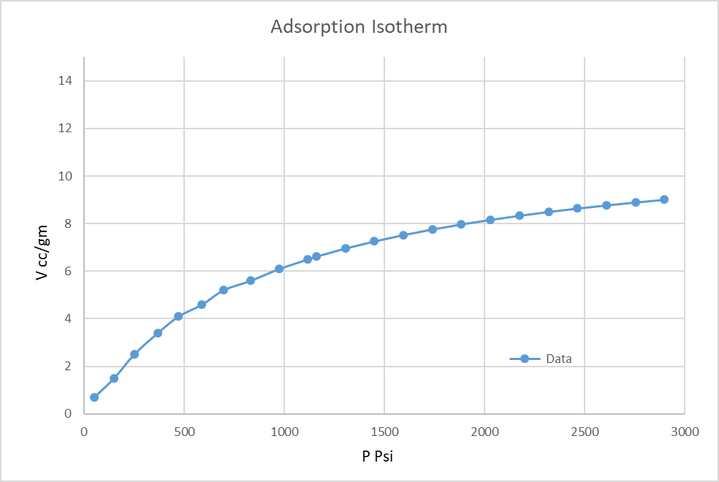
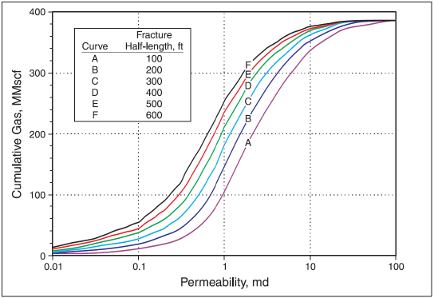
PROBLEM STATEMENT & POSSIBLE SOLUTIONS
Dewatering
Increase in frac
length can enhance the gas
production
CDP
Source: Modified from Hunt and Steele (1991).
Problem Statement:
In deeper wells early gas breakout confirms the having good gas content, good gas saturation recorded in core well. But the production rate fails to sustain due to lower permeability (0.5- 2 mD)
Possible solution for increase in optimum production: Increasing effective reservoir drainage
Optimization of well spacing
Maximize the reservoir contact area
Increase in fracture length in vertical-deviated wells –
In higher permeability region, impact of frac length on productivity is relatively limited. As the permeability decreases the half frac length becomes crucial for sustainable production
Focus on maximizing propped length
Horizontal well/ Multilateral wells

Slide 2
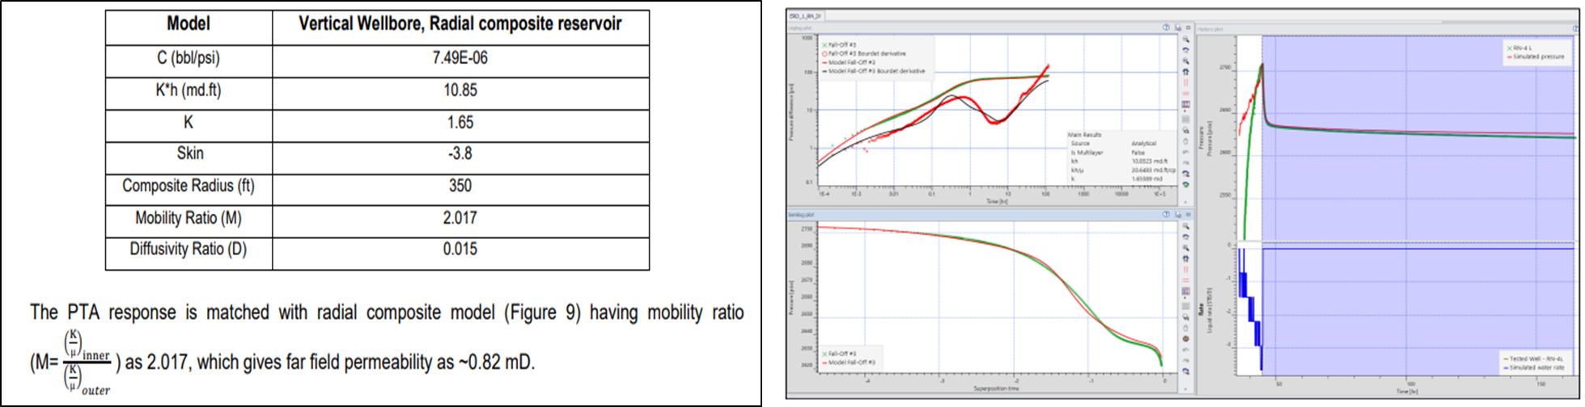
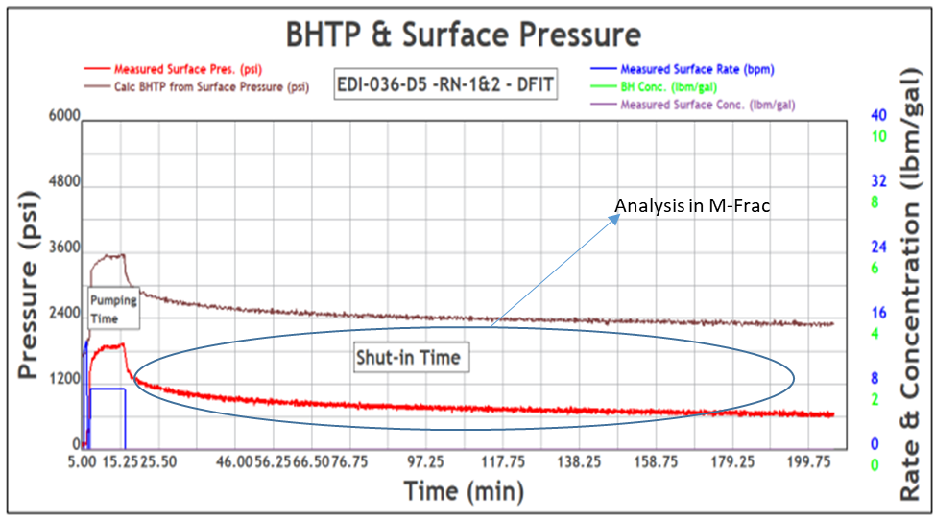
IFT & DFIT DATA ANALYSIS OF DEEPER COAL SEAMS
Step rate injection
Perf & Near well bore friction
Extension rate & Pressure
DFIT
Closure pressure & Time
Fluid Efficiency /Leak off
Pore pressure & Permeability
IFT data: 2.017mD (near wellbore),0.82mD (Far field)
DFIT CLOSURE PRESSURE: 2450 psi

Slide 3
PROBLEM STATEMENT- DEEPER COAL SEAMS PERMEABILITY & CONNECTIVITY
Deeper coal seams shows good content & saturation
Corroborating different data (Petrophysical , IFT & DFIT data), the deeper coal seams are concluded to be tighter
Permeability Data Indicators
Dipole sonic data-Decrease in anisotropy
IFT data-Permeability <2mD
DFIT data-Higher closure pressure
All the data speaks to each other
To optimize the Frac Job
Geo-mechanical properties derived from the core analysis and petrophysical log analysis becomes critical input for job simulation at different depths
Pre-frac test results to be incorporated for better understanding and successful job planning
Integration of Petrophysical data, Geomechanical properties , IFT & DFIT data helps in frac design

Slide 4
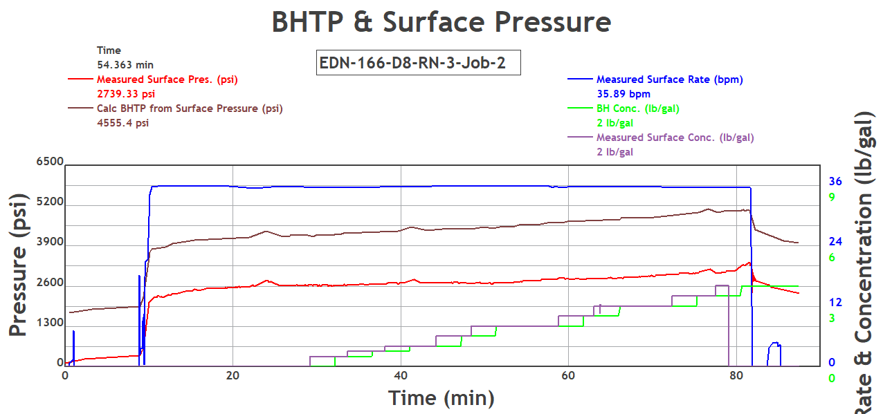
POSSIBLE SOLUTION-FRAC DESIGN OPTIMIZATION
Job details |  |  |  |  |  |  | Simulation Results
Case | Rate | Gel loading (gpt) | 20/40 (%) | 40/70 (%) | Sand yield (lbs/ft) | Max PPA | Fracture length(ft) (propped) | Fracture width (in.) | Height (propped) (ft) | Frac conductivty
1 | 36 | 7.5 | 100 | 0 | 4000 | 3 | 320 | 0.28 | 15.7 | 708
2 | 36 | 7.5 | 100 | 0 | 8000 | 5 | 499 | 0.33 | 15.7 | 1260
3 | 36 | 7.5 | 100 | 0 | 4000 | 5 | 340 | 0.3 | 15.7 | 881
4 | 36 | 7.5 | 75 | 25 | 4000 | 3 | 350 | 0.27 | 15.7 | 718
5 | 36 | 7.5 | 75 | 25 | 8000 | 5 | 555 | 0.36 | 15.7 | 1180
6 | 36 | 7.5 | 75 | 25 | 4000 | 5 | 448 | 0.29 | 15.7 | 706
Improved Frac Design
Maximizing sand yield
Incorporation of smaller sand i.e. 40/70 for longer frac length.
Pumping lesser viscosity gel in pre-pad.
Slow ramp of Proppant to prevent early screen out.
Use of higher viscosity gel and Proppant slug in high leak off seam.

Slide 5
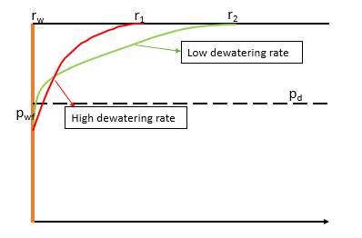
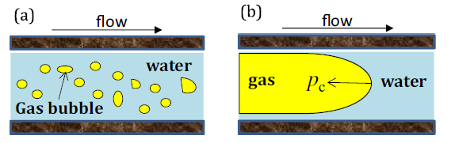
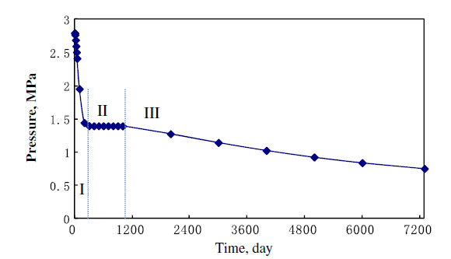
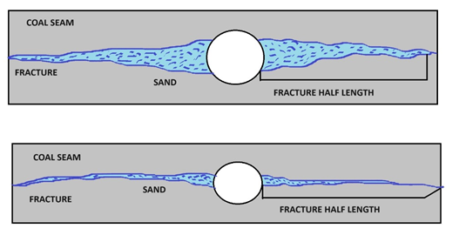
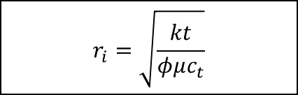
DEWATERING RATE OPTIMIZATION
Slow dewatering rate increase the radius of investigation
a) Interfacial tension b) Capillary pressure
$$r_{i}=\sqrt{\frac{kt}{φμc_{t}}}$$
Two phase flow reduces the pressure propagation velocity
Stage 1 – Dewatering Stage
Stage 2 – Desorption zone extension stage
Stage 3 - Gas desorption stage
Pressure change at the boundary point
High dewatering rate reduce the fracture path by ingress of coal fines .
Primary focus to extend stage 1 Single phase dewatering stage to maintain pressure above CDP to extend radius of investigation

